Slide 1

Searching and Modification of Data in Binary Search Tree
Data Structure | Tree and Heap
Course: Data Structure | Chapter: Tree and Heap | Program: Bachelor of Engineering
DISCOVER · LEARN · EMPOWER
Notes:
Welcome everyone to today's session on Binary Search Trees. We will focus specifically on how to search for and modify data within these structures. This builds directly on our previous understanding of tree traversal. Remember, efficiency is key when dealing with large datasets in engineering applications.

Slide 2
Course Outcomes
SLIDE 2 / 14
Course Outcome
CO | BT LEVEL | DESCRIPTION
CO1 | BT1 | Understand and apply basic data structures, algorithms, complexity analysis, ADTs, arrays and linked lists.
CO2 | BT2 | Apply and implement stacks and queues in problem-solving.
CO3 | BT3 | Analyse and apply searching, sorting, and hashing techniques.
CO4 | BT4 | Construct and apply tree structures and traversal techniques.
CO5 | BT5 | Represent and solve graph problems using DFS, BFS, and graph algorithms.
Chandigarh University
2 / 14
Notes:
Today's lecture directly addresses CO4 by having you construct and apply tree structures for searching. We also touch upon CO5 as tree traversal techniques are foundational for graph algorithms like DFS. Please note that while we focus on trees, the logic transfers to graph representations. These outcomes ensure you can solve real-world data organization problems.

Slide 3
Learning Objectives
SLIDE 3 / 14
Learning Outcomes
1
Analyze the time complexity of searching operations in a BST.
2
Demonstrate the step-by-step process of inserting a new node.
3
Evaluate the three distinct cases required for node deletion.
4
Apply recursive logic to modify data values within the tree.
5
Compare the efficiency of BST operations against linear search methods.
Chandigarh University
3 / 14
Notes:
By the end of this class, you will be able to analyze how fast our searches are. You will demonstrate exactly how to insert a number into a tree without breaking its order. We will also evaluate the tricky cases when deleting a node with two children. Finally, you will apply these skills to modify data efficiently.

Slide 4
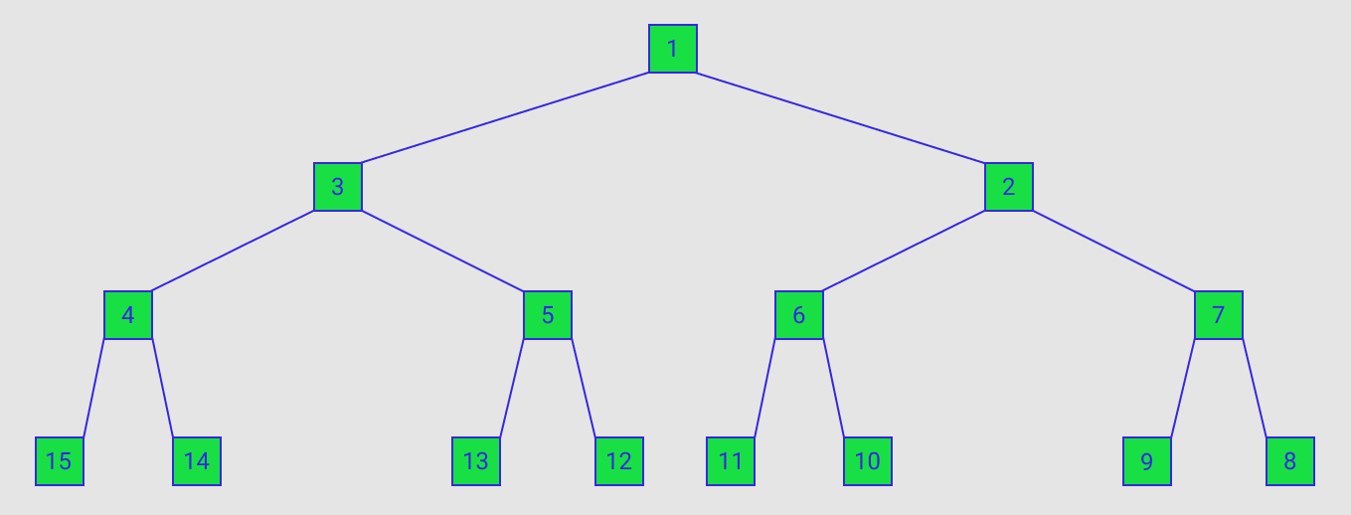
Lecture
SLIDE 4 / 14
BST Search Principle and Logic
1
Search starts at the root and compares the target value with the current node.
2
If the target is smaller, the algorithm moves exclusively to the left child.
3
If the target is larger, the algorithm moves exclusively to the right child.
4
The process repeats recursively until the value is found or a null pointer is reached.
5
This binary decision process eliminates half of the remaining nodes at each step.
6
The search time complexity is O(log n) for balanced trees and O(n) for skewed trees.
7
A successful search returns the node pointer, while a failed search returns null.
Path in ZigZag Labelled Binary Tree - Daniel Leskosky
Chandigarh University
4 / 14
Notes:
Think of searching a BST like looking up a word in a dictionary. You open to the middle, see if the word is before or after, and discard half the book. If we search for 45 in a tree with root 50, we go left. If we search for 60, we go right. This logic ensures we never check unnecessary nodes.

Slide 5

Lecture
SLIDE 5 / 14
Insertion Algorithm and Steps
THE BST PROPERTY MUST BE MAINTAINED
left child is always smaller than the parent.
• Insertion begins by searching for the correct leaf position for the new data value.
• If the tree is empty, the new node becomes the root of the entire structure.
• If the new value is less than the current node, it moves to the left subtree.
• If the new value is greater than the current node, it moves to the right subtree.
• The algorithm stops when it finds a null pointer, where the new node is attached.
• Duplicate values are typically rejected or stored in a specific left/right convention.
Source: study.com
Chandigarh University
5 / 14
Notes:
Let's insert the value 30 into a tree with root 50. Since 30 is less than 50, we go left. If the left child is 20, we go right because 30 is greater. We keep going until we find an empty spot. This ensures the tree remains sorted. Always check for duplicates to avoid infinite loops or data redundancy.

Slide 6
Deletion Case 1
SLIDE 6 / 14
Leaf Node Removal
EXAMPLE
Removing 10 from a tree where 10 is a child of 20.
• A leaf node has no children and can be removed without affecting tree structure.
• The parent node's pointer to the leaf is simply set to null.
• This operation is the simplest form of deletion in a Binary Search Tree.
• No restructuring of the remaining tree is required after removing a leaf.
• Memory allocated to the leaf node should be freed to prevent leaks.
• The BST property remains valid because no other nodes depend on the leaf.
Chandigarh University
6 / 14
Notes:
Removing a leaf is like cutting a branch off a tree; the rest of the tree stays healthy. If node 10 is a leaf, we just tell its parent, 'I no longer have a child here.' We set the parent's pointer to null. This is the easiest case because no other nodes need to be rearranged. Always remember to free the memory in C.

Slide 7
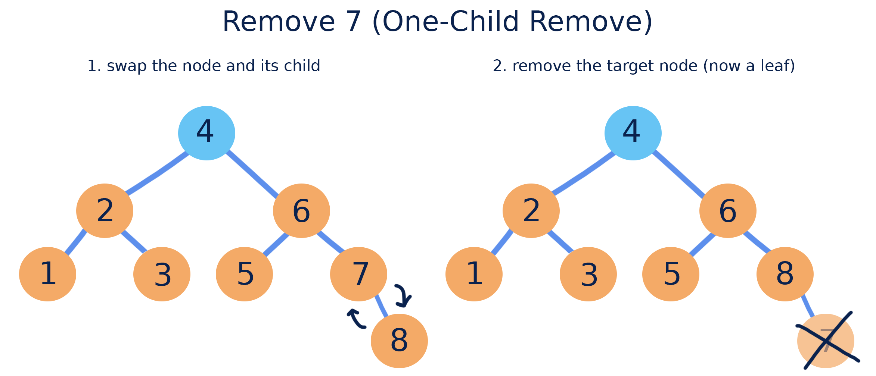
Deletion Case 2
SLIDE 7 / 14
One Child Node
EXAMPLE
Removing 20 which has only a right child 30.
• A node with one child is replaced by its single child node.
• The parent of the deleted node now points directly to the child.
• This effectively bypasses the deleted node in the tree hierarchy.
• The BST property is preserved because the child maintains the correct order.
• If the deleted node is the root, the child becomes the new root.
• This operation requires updating exactly one parent pointer to the child.
Source: courses.grainger.illinois.edu
Chandigarh University
7 / 14
Notes:
When a node has only one child, we promote that child to take the parent's spot. Imagine node 20 has a child 30; we remove 20 and make 30 the child of 20's parent. This maintains the sorted order because 30 is still greater than 20's parent. It is a simple pointer update that keeps the tree connected.

Slide 8
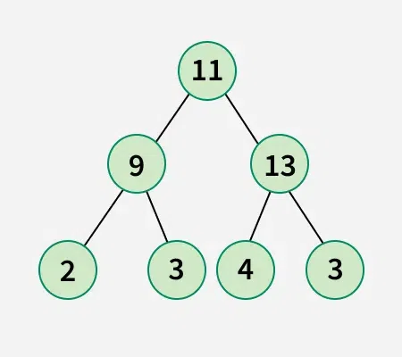
Deletion Case 3
SLIDE 8 / 14
Two Children Node
EXAMPLE
Replacing 50 with 45 (predecessor) or 55 (successor).
• A node with two children cannot be simply removed without breaking the tree.
• The node is replaced by either its in-order predecessor or in-order successor.
• The in-order predecessor is the largest value in the left subtree.
• The in-order successor is the smallest value in the right subtree.
• After copying the value, the predecessor or successor node is recursively deleted.
• This ensures the BST property is maintained for all remaining nodes.
Source: media.geeksforgeeks.org
Chandigarh University
8 / 14
Notes:
This is the hardest case. If we remove a node with two children, we can't just delete it. We find its successor, say 55, copy 55 into the node's place, and then delete the original 55. Since 55 was a leaf or had one child, we use the simpler deletion logic now. This preserves the sorted order perfectly.

Slide 9
Worked Numerical Example
SLIDE 9 / 14
Insertion
1
Initial tree contains root 50 with left child 30 and right child 70.
2
Insert value 20: Compare with 50 (go left), compare with 30 (go left).
3
Insert value 20: 30 has no left child, so attach 20 as left child of 30.
4
Insert value 60: Compare with 50 (go right), compare with 70 (go left).
5
Insert value 60: 70 has no left child, so attach 60 as left child of 70.
6
Final tree structure maintains the property: left < root < right for all nodes.
7
Total nodes increased from 3 to 5 while maintaining the binary search order.
Chandigarh University
9 / 14
Notes:
Let's trace inserting 20 and 60. Start with 50, 30, 70. For 20, we go left from 50, then left from 30. We attach it there. For 60, we go right from 50, then left from 70. We attach it there. The tree now has 5 nodes. Notice how 20 is still less than 30, and 60 is less than 70. The order is preserved.

Slide 10
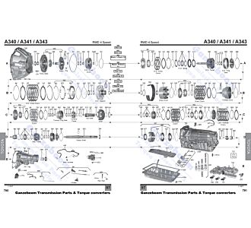
Worked Numerical Example
SLIDE 10 / 14
Deletion
THE BST PROPERTY HOLDS
40 < 50 < 70 after the modification.
• Consider a tree with root 50, left child 30, and right child 70.
• Delete node 30 which has a left child 20 and right child 40.
• Find in-order successor of 30, which is the smallest in the right subtree.
• The successor is 40, so replace 30 with 40 in the tree structure.
• Now delete the original node 40, which is a leaf in this context.
• The resulting tree has root 50, left child 40, and right child 70.
Source: webshop.ganzeboom.net
Chandigarh University
10 / 14
Notes:
We delete 30, which has two children. We find its successor, which is 40. We copy 40 into 30's spot. Now we delete the original 40. Since 40 was a leaf in the right subtree, we just remove it. The tree now has 40 where 30 was. 40 is still less than 50, so the tree is valid.

Slide 11
Lecture
SLIDE 11 / 14
Common Pitfalls in BST Operations
1
Failing to handle the case where the node to delete is the root node.
2
Incorrectly identifying the in-order predecessor or successor during deletion.
3
Not updating parent pointers correctly when a node is replaced.
4
Creating unbalanced trees by inserting sorted data without rebalancing.
5
Memory leaks occur if the deleted node is not explicitly freed in C.
6
Infinite loops happen if the search logic does not handle null pointers.
7
Ignoring duplicate values can lead to unexpected behavior in search results.
Chandigarh University
11 / 14
Notes:
A common mistake is forgetting that the root might be the node you delete. Another pitfall is picking the wrong successor. Always check if the successor has a left child. Also, inserting 1, 2, 3, 4 creates a line, not a tree, making searches slow. Always free memory in C to avoid leaks. These errors break the BST logic.

Slide 12
Lecture
SLIDE 12 / 14
Time Complexity Analysis
1
Best case search time is O(log n) for a perfectly balanced tree.
2
Average case search time is O(log n) for randomly inserted data.
3
Worst case search time is O(n) for a skewed or linear tree.
4
Insertion and deletion operations share the same complexity as searching.
5
The height of the tree determines the maximum number of comparisons needed.
6
Balancing algorithms like AVL or Red-Black trees prevent worst-case scenarios.
7
Understanding complexity helps in choosing the right data structure for engineering tasks.
Chandigarh University
12 / 14
Notes:
If your tree is balanced, you only check about log base 2 of n nodes. For 1000 nodes, that's about 10 checks. But if you insert sorted data, the tree becomes a line, and you check all 1000 nodes. This is O(n). That's why we use balancing algorithms in real systems. Always consider the worst case for critical applications.

Slide 13
Lecture
SLIDE 13 / 14
Key Takeaways
1
BST search uses binary comparison to eliminate half the tree at each step.
2
Insertion places new nodes at leaf positions to maintain sorted order.
3
Deletion of a node with two children requires replacing it with a successor.
4
The efficiency of BST operations depends heavily on the tree's balance.
5
Proper pointer management and memory freeing are critical for C implementations.
6
Understanding these operations is essential for solving complex graph problems.
Chandigarh University
13 / 14
Notes:
To summarize, remember that search is fast if the tree is balanced. Insertion is straightforward but requires finding the right leaf. Deletion is complex for nodes with two children. Always check your tree balance to avoid O(n) performance. And never forget to free memory in C. These are the core concepts you need for CO4.

Slide 14
Lecture
SLIDE 14 / 14
References
DATA STRUCTURES
A Pseudocode Approach with C — Gilberg, Forouzan
• Data Structures — Lipschutz
• Data Structure Using C — AK Sharma
• C and Data structure — P. S. Deshpandey
Chandigarh University
14 / 14
Notes:
For further reading, please refer to the books listed on this slide. Gilberg and Forouzan provide excellent pseudocode approaches. Lipschutz is great for theory. Sharma and Deshpandey offer deep C implementations. These resources will help you master the algorithms we discussed today. Thank you for your attention.

